Slide 1



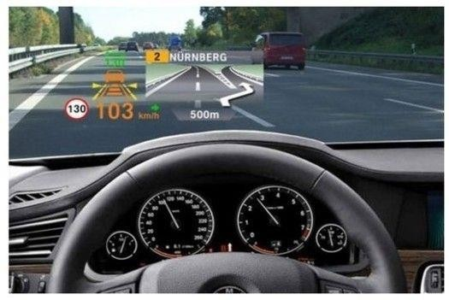


Identifying Voice Of Customers for Automotive Gadgets using Twitter/Facebook User Comments
Suresha K
BA05, SRN R19MBA11
Mentor : Akshay Kulkarni

Slide 2

Agenda
Introduction
Problem Statement Technical Solution Design Data Pipeline
Framework – CRISP-DM Analysis
Future Scope

Slide 3
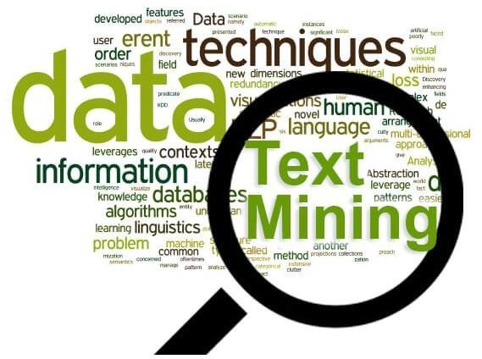
Introduction
Analytics – a megatrend today!
Social networking sites – huge source for consumer voices
Twitter and Facebook – ready to use information
Data – can be analyzed using text analysis
Can predict – sentiments towards the product
Cost – reduced amount of cost
Time – reduced turnaround time
Big data – able to handle large amount of data

Slide 4

Problem Statement
“ Identify voice of customers for automotive gadgets using user
comments in Twitter and Facebook and to know the sentiments of
customers by which enterprises can do business decision making for market research of their product ”

Slide 5
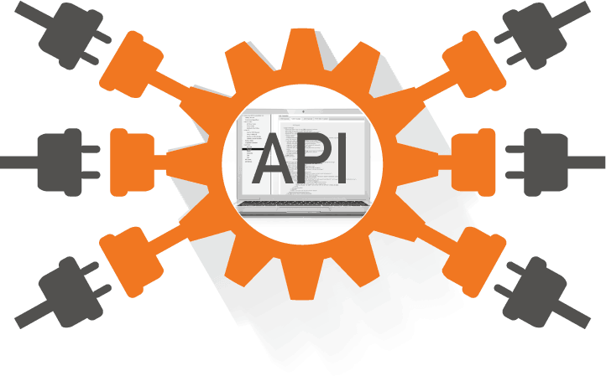
Technical Solution Design
Deployment:
→Dashboard
→State of the art API
Validation:
→Accuracy
→Precision
→Recall
→F1-Score
→Comparison of
models
Modeling / Classifiers:
→Lexicon
→TextBlob
→VADER
Text Preprocessing /
EDA:
→Stop Words
→Stemming, Lemmatization
→Standardize
→Text to Features
Data Extraction:
→Comments from Facebook
→Tweets from
Twitter
→Support Vector Classifier
→Gradient Boosting
→Decision Tree
→Random Forest
→Gaussian NB Classifier
Phase - I
Phase - II
→Word Embedding – TF-IDF, Word2Vec
→Transfer Learning – Fine
Tuning BERT

Slide 6
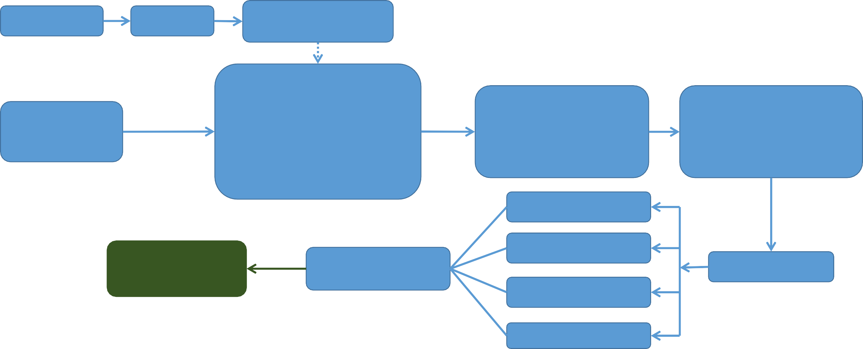
Data Pipeline
Lexicon File
Lexicon
Lexicon Based Scoring
Text Preprocessing
Tokenize
Stop Word Removal
Stemming
Lemmatization
Normalization
Exploratory Data
Analysis
Word Frequency
Word Cloud
Feature Extraction
Bag Of Words
TF-IDF
Word Embedding
Tweets & Comments
Classification
Dashboard &
API
Phase - II
Discovery
Voice Of
Customers
Sampling
Summary
Topic Detection

Slide 7

Framework – CRISP-DM
Business Understanding
Data Understanding Data Preparation Modelling
Evaluation
CRoss Industry Standard Process for Data Mining
Deployment

Slide 8
Business Understanding
Approx. 64% of the respondents used a smartphone application to assist with their travel
Navigation and Real-time Traffic Information Systems, Safety, Bluetooth, In-Vehicle
Technology
100 million users generating over 500 million tweets every day
Facebook is used by a large number of people on earth for expressing their ideas,
thoughts, sorrows, pleasures and poems
Facebook is the most widely adopted social media platform by brands and companies
Extremely required for quick, agile decisions with business perspective to use ML / AI
technologies like NLP, Text Mining
It is imperative and an opportunity to use NLP as a front end API

Slide 9
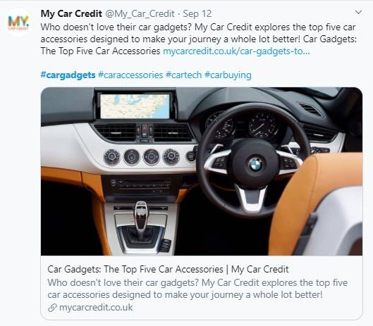
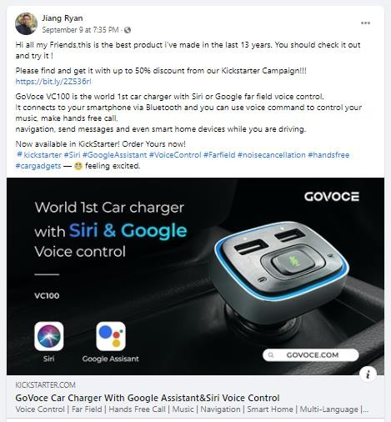


Data Understanding
#CarGadgets | #CarSpeakers | #Dashboard
#Infotainment | #CarGPS | #HUD
#AndroidAuto | #ConnectedVehicles | #DashCamera
#AppleCarPlay | #CarCockpit | #GPSNavigation
#InCarEntertainment | #JBLAudio | #SelfDriving
#CarAccessories | #DashCam | #Dashcam
#CarMusic | #CarAudioSystem | #AutonomousVehicles
#CarAudio | #CarNavigation | #AutonomousDriving
#AmazonEchoAuto | #CarCamera | #SelfDrivingCars
#CarInterior | #CarMobileHolder | #CarCharger
#Gadgets | #CarStereo | #ElectricCar
#SelfDrivingCars | #CarVideo | #CarCharging
The user comments are normally attached with hashtags in any social network
Hashtags help users to find the messages for specific theme or content

Slide 10
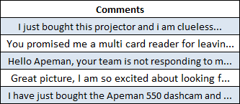
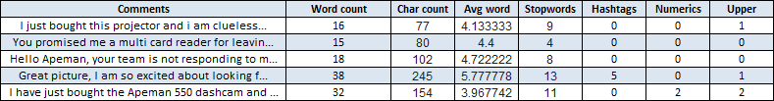
Data Understanding…
Data extracted through Twitter API and Export
Comments APIs
The data has user comments for 9,546 rows from Twitter and Facebook
Comments/Tweets extracted for about 36 hashtags
related to user comments on automotive gadgets
Initial Comments Extracted
Understanding of Data

Slide 11
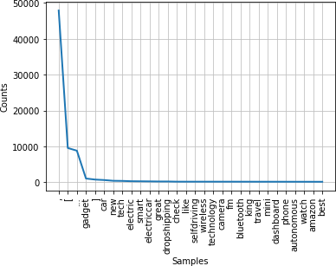
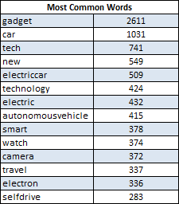
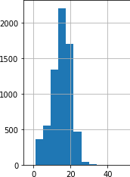
Data Preparation
Text Preprocessing:
Stop Words Removal
Split sentences into words and lower case
Handles Removal like @, URLs etc.
Standardize: Full Forms, Lower Texts, Emojis
Spell Corrections, removal of punctuations
Join words to form the original sentences
Tokenize
Stemming and Lemmatization
Create Corpus
Frequency Distribution
Bag of Words
Word Cloud and Word Frequency
Length of Comments

Slide 12
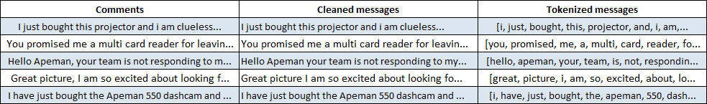
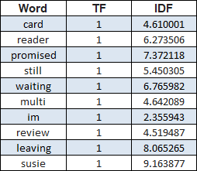
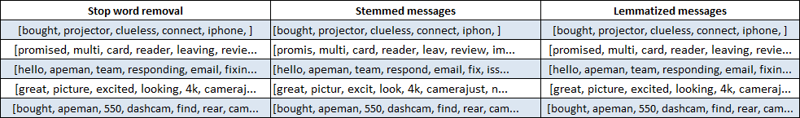
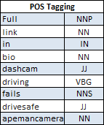
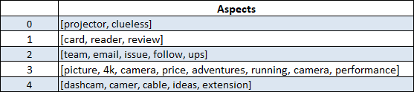

Data Preparation…
Text Preprocessing…

Slide 13
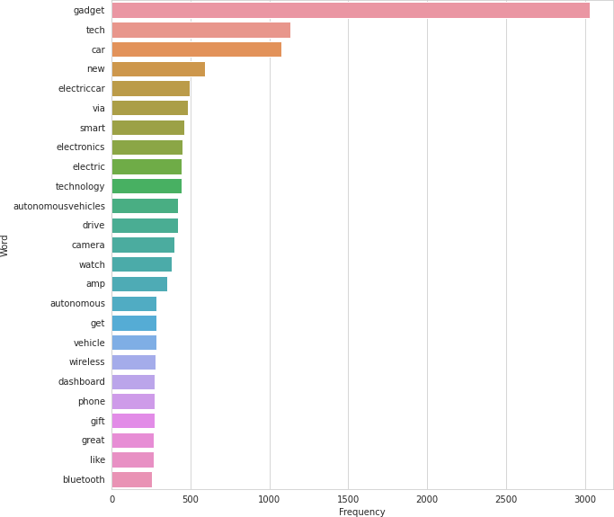
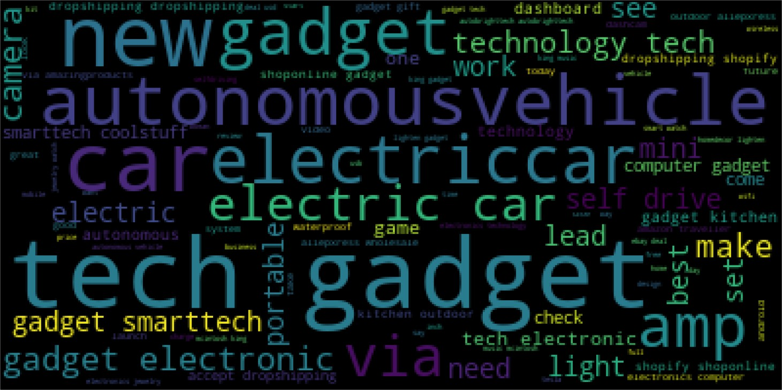
Data Preparation…
Exploratory Data Analysis:
Word Cloud
Word Frequency

Slide 14
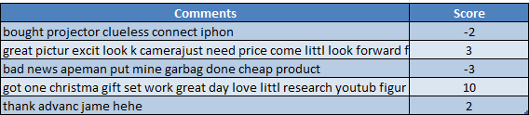
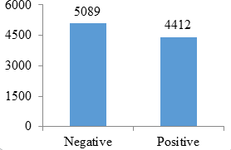
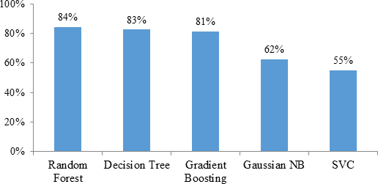
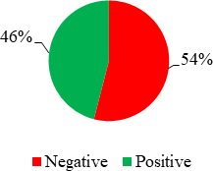
Modelling – Lexicon Approach
Lexicon Model using AFINN (Finn Årup
Nielsen)
It has over 3,300+ words and it has a
polarity score associated with each word

Slide 15
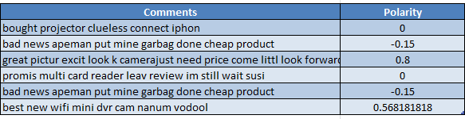
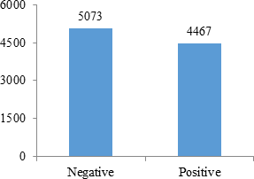
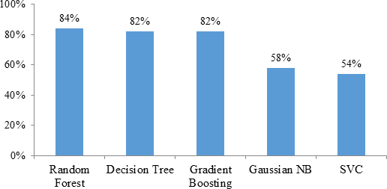
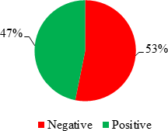
Modelling – TextBlob Sentiment
Polarity using TextBlob
The sentiment function of TextBlob returns two properties, polarity and subjectivity
Polarity is float which lies in the range of [-1,1] where 1 means positive statement and -1 means a negative statement

Slide 16
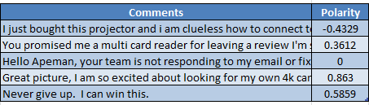
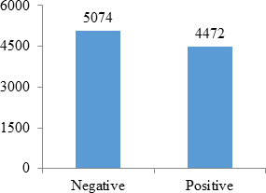
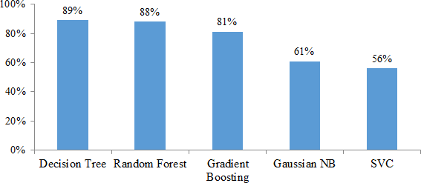
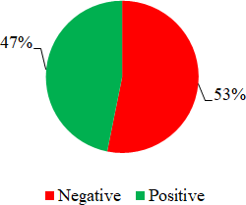
Modelling – VADER Sentiment
Valence Aware Dictionary and sEntiment Reasoner
It comes under rule-based systems
Sensitive to the polarity and intensity of the emotions of the user
Constructed from a valence based and able to
generalize sentiment

Slide 17
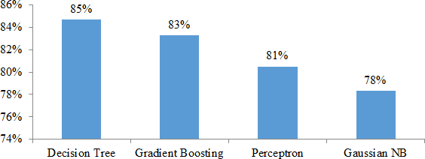
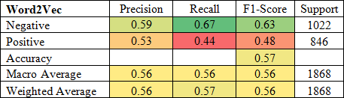
Modelling – Word Embedding
New way of representing words into vectors
Will redefine the high dimensional word features into low dimensional feature
Preserves the contextual similarity in the corpus
TF-IDF Vectorizer:
Converts the text documents into vector models
Based on the occurrence of words in the documents without taking considering the exact ordering
Term Frequency measures how frequently a term occurs in a document
inverse Document Frequency measures how importance the term is
TF-IDF Vectorizer
Word2Vec:
Input for Word2Vec is a text corpus
Produces the word vectors as output
Vocabulary is constructed first from the training text data
Learns vector representation of words
Resulting word vector will be used as features in NLP applications
Word2Vec

Slide 18
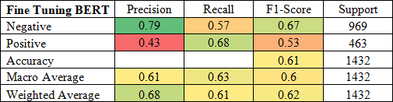
Modelling – Transfer Learning
Acquires the knowledge while solving one problem and applies it to a different but related problem
It re-uses the pre-trained model on a new problem
Introduced by Google
Fine Tuning with BERT:
Bidirectional Encoder Representations from
Transformers
First deeply bidirectional unsupervised language representation
Pre-trained using plain text corpus

Slide 19
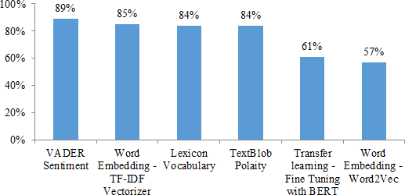
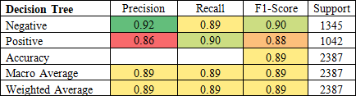
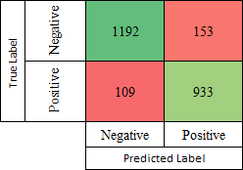
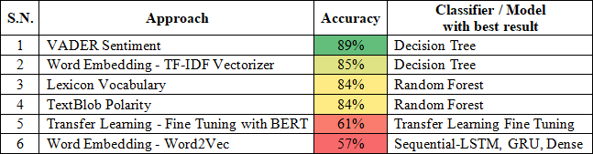
Evaluation
VADER sentiment with Decision Tree Classifier has
given the highest accuracy of 89%
Word Embedding with TF-IDF Vectorizer has the second best accuracy of 85%
The Precision, Recall and F1-Score of VADER Sentiment are as shown below:
Results of VADER Sentiment
Comparison of Accuracies

Slide 20
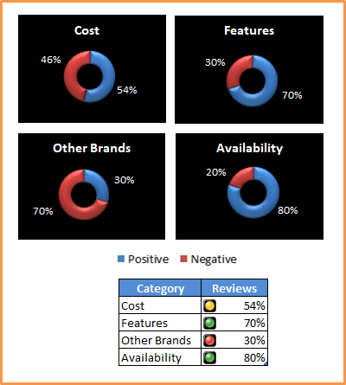
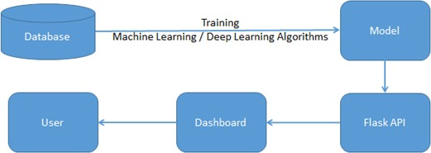
Deployment
As future plan in Phase – II, deployment of state of the art API and dashboard
have been planned:
Deployment Plan
Dashboard Plan

Slide 21
Analysis

Slide 22

Future Scope
The model performance can be improved by focusing on:
Having more dataset
Topic modeling for more data points
Handling class imbalance for bigger dataset
Domain specific support for accurate labelling by specific
corpus
More efficient negation handling
Exploring other techniques like GloVe, fastText for word embedding and comparing the results with the results obtained in this study
Emotion detection and predicting the comments
Identify comments from fake accounts
Dashboard and state of the art API

Slide 23
GitHub link of Python Codes: https://github.com/sureshakukkaje/NLP---Voice-Of-Customers-Automotive-Gadgets

